Slide 1
Chapter 1 – Architectural Design
Software Architecture and Design
Mutah University
Faculty of IT
Department of Software Engineering
Dr. Ra’Fat A. AL-Msie’Deen
rafatalmsiedeen@mutah.edu.jo
https://rafat66.github.io/Al-Msie-Deen/

Slide 2
Reference - Text Book:
Chapter 6 of Software Engineering book - by Ian Sommerville. l0th Edition. Addison Wesley, 2015, ISBN-10: 0137035152.

Slide 3
Topics covered
Architectural design decisions
Architectural views
Architectural patterns
Application architectures

Slide 4
Application architectures Transaction processing systems

Slide 5
Transaction processing systems
Transaction processing systems are designed to process user requests for information from a database, or requests to update a database (Lewis, Bernstein, and Kifer 2003).
Technically, a database transaction is part of a sequence of operations and is treated as a single unit (an atomic unit).
All of the operations in a transaction have to be completed before the database changes are made permanent.
This ensures that failure of operations within a transaction does not lead to inconsistencies in the database.

Slide 6
Transaction processing systems … cont.
From a user perspective, a transaction is any coherent sequence of operations that satisfies a goal, such as “find the times of flights from London to Paris.”
If the user transaction does not require the database to be changed, then it may not be necessary to package this as a technical database transaction.

Slide 7
Transaction processing systems … cont.
An example of a database transaction is a customer request to withdraw money from a bank account using an ATM.
This involves checking the customer account balance to see if sufficient funds are available, modifying the balance by the amount withdrawn and sending commands to the ATM to deliver the cash.
Until all of these steps have been completed, the transaction is incomplete and the customer accounts database is not changed.

Slide 8
Transaction processing systems … cont.
Transaction processing systems are usually interactive systems in which users make asynchronous requests for service.
Figure 1 illustrates the conceptual architectural structure of transaction processing applications.
First, a user makes a request to the system through an I/O processing component.
The request is processed by some application-specific logic.
A transaction is created and passed to a transaction manager, which is usually embedded in the database management system.
After the transaction manager has ensured that the transaction is properly completed, it signals to the application that processing has finished.

Slide 9
Transaction processing systems … cont.
Process user requests for information from a database or requests to update the database.
From a user perspective a transaction is:
Any coherent sequence of operations that satisfies a goal;
For example - find the times of flights from London to Paris.
Users make asynchronous requests for service which are then processed by a transaction manager.

Slide 10

The structure of transaction processing applications
Figure 1. The structure of transaction processing applications.

Slide 11
Transaction processing systems … cont.
Transaction processing systems may be organized as a “pipe and filter” architecture, with system components responsible for input, processing, and output.
For example, consider a banking system that allows customers to query their accounts and withdraw cash from an ATM.
The system is composed of two cooperating software components — the ATM software and the account processing software in the bank’s database server.
The input and output components are implemented as software in the ATM, and the processing component is part of the bank’s database server.
Figure 2 shows the architecture of this system, illustrating the functions of the input, process, and output components.

Slide 12
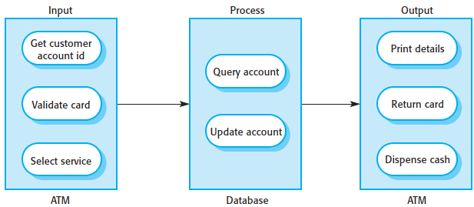
The software architecture of an ATM system
Figure 2. The software architecture of an ATM system.

Slide 13
Key points
Models of application systems architectures help us understand and compare applications, validate application system designs and assess large-scale components for reuse.
Transaction processing systems are interactive systems that allow information in a database to be remotely accessed and modified by a number of users.

Slide 14
Chapter 1 – Architectural Design
Software Architecture and Design
Mutah University
Faculty of IT
Department of Software Engineering
Dr. Ra’Fat A. AL-Msie’Deen
rafatalmsiedeen@mutah.edu.jo
https://rafat66.github.io/Al-Msie-Deen/

